Slide 1


BES171: Banking, Finance & Insurance
Money Evolution
Monetary Policy
Evolution & Classification of FI
Digital Payment
BASEL, NPA, TBS, Bad Bank-PARA
Finance, Insurance & Fin.

Slide 2
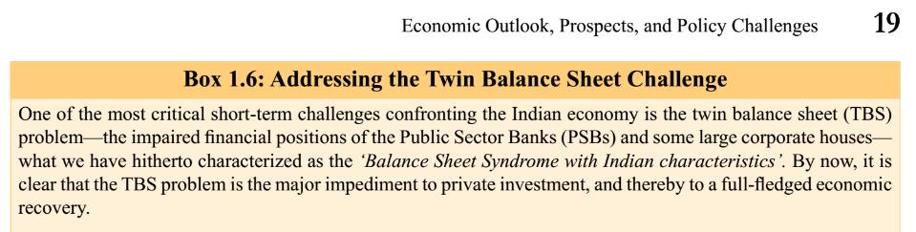
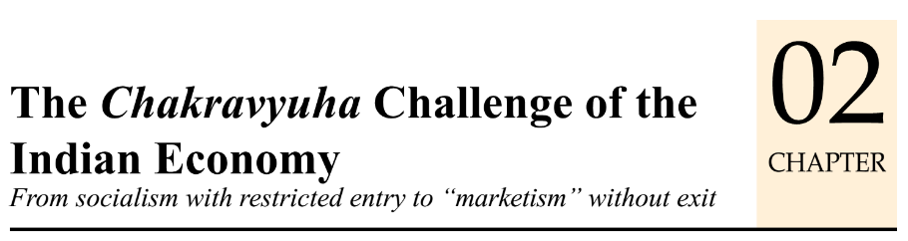
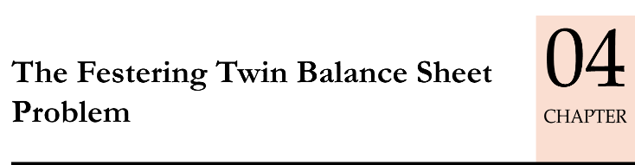
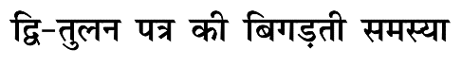
Last year’s survey
This year’s survey
+ budget17 also mentioned
NPA problem
Insolvency-bankruptcy code
Indradhanush etc.

Slide 3

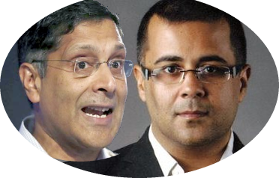

I’m Arvind Subramanian of English fiction
UPSC got into habit of asking “Contemporary” topics that are ~1.5-2 years old (WEF Prelim-2016)
“BES17” series
Compress, consolidate old material
Update with new developments
FAST Revision
I’m Chetan Bhagat of Economic surveys
…same themes repeated in
3 surveys that Arvind has written
NPA: 1st survey: “NPA renegotiation commission”,
3rd survey “PARA- Bad Bank”
Tax, Labour, Subsidy reform,
As much as I hate teaching old things again, they’ve to be taught again.

Slide 4
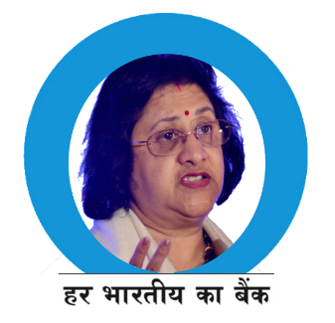


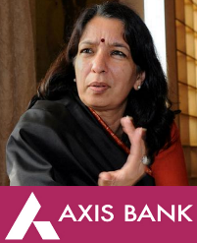
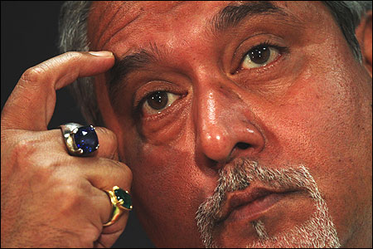
Total NPA in SCB: Rs.9.6 lakh crores (31/12/2016)
Mug up this number
Twin Balance Sheet Problem
PSB
Large Corporates

Slide 5
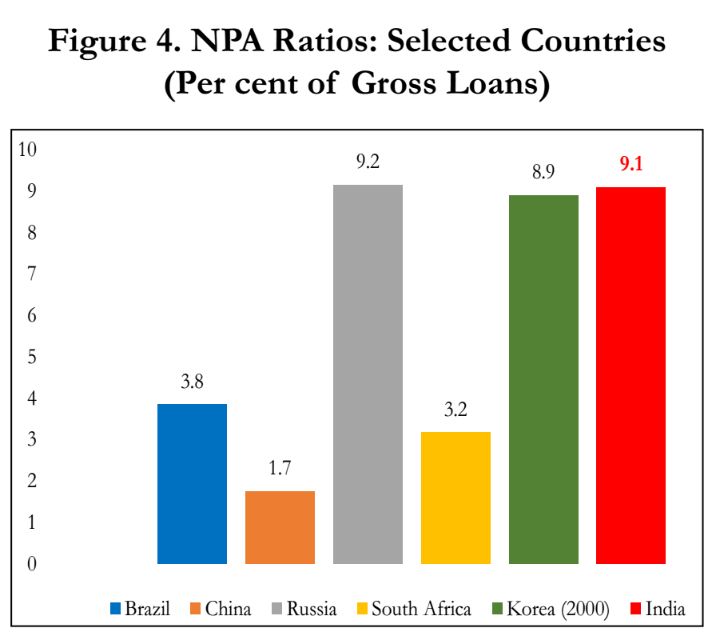
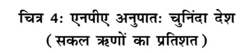
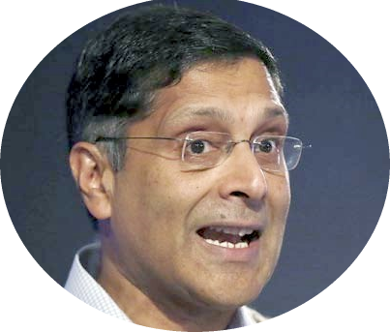

Among BRICS, India has highest NPA after Russia ☹
हिन्दुस्तानियो NPA Control करना हमसे सीखो.
- 11th Jingping
PSB:
12%

Slide 6

TBS, NPA problem
Genesis: 3 Stage
3 "R", SDR, S4A
I&B Code 2016
PARA-Bad Bank
Windfall Profit
Moral Hazard 4R4D
Money to Open Bad bank

Slide 7


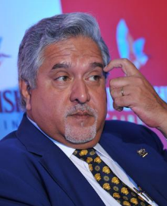


Twin Balance sheet & NPA problem: 3 stages
Surge in Borrowing
Fall in Demand
Debt Servicing Problem
GFC, Policy Paralysis
During Boom
NPA,TBS

Slide 8
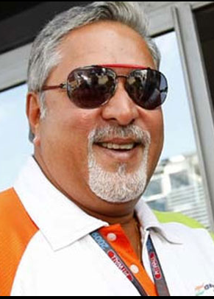
Surge in borrowing
Stage:1
Mid-2000s: all growing @9-10%
India Corporates thought it’s LPG-impact, now we’ll get twin-digit growth like China for years!
Hence heavy investment esp. in infra projects, real estate, highway, powerplants….bidding & investment
Overleverage, high debt to equity.
क्योकि खुद के पैसे से धंधा केवल कच्चे खिलाड़ी करते है!

Slide 9

Fall in Demand GFC, Scams, Policy Paralysis
Stage:2
Global financial crisis: international demand ▼; local demand ▼ (IT, aviation), textile competition from East Asia
To boost demand: Price wars in aviation, telecom: bleeding balance sheets.
“Fiscal stimulus”: excise duty break on automobile; parallel Aviation fuel tax ▲
Rupee weakened: from Rs.40/$ to Rs.70/$ [good for export, but bad for ECB & foreign debt repayment.]
2G, coal & CWG scam: Judicial activism, policy paralysis. Mines-railways-Power companies; PPP unable to break-even costs due to tariff control.
double digit inflation: demand ▼, RBI raises policy rate-> Lending rates ▲; difficult to get new loans.
क्या करू? सेल्स बढाऊ तो कैसे?

Slide 10
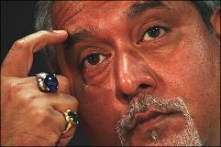
Debt servicing problems
Stage:3
40% of corporate loans are IC1 companies [Interest coverage ratio less than 1]
IC1 = co. not generating enough revenue to even repay loan interest!
Ever greening of loans: new loans to payoff interest on old loans.
Companies tried to selloff assets but not getting proper price.
मुद्दल तो क्या ब्याज भी चुकाना मुश्किल है! ☹

Slide 11
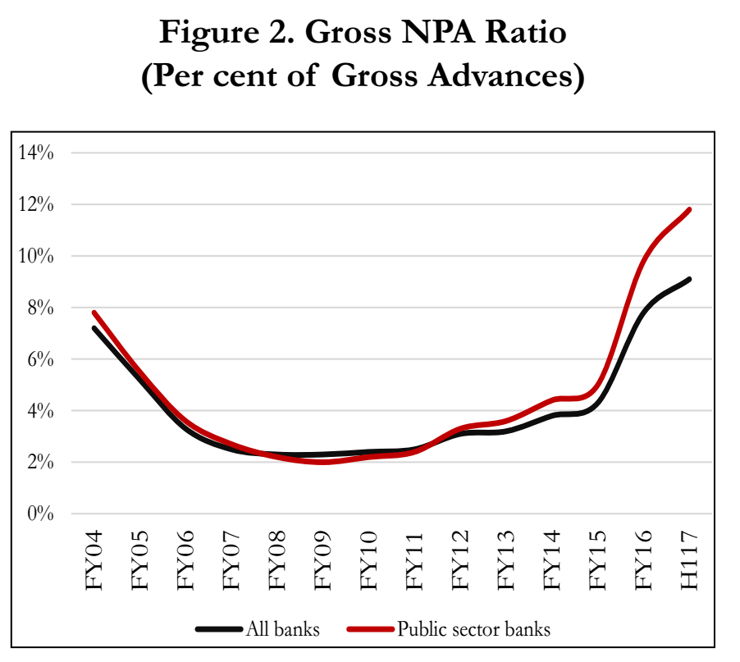
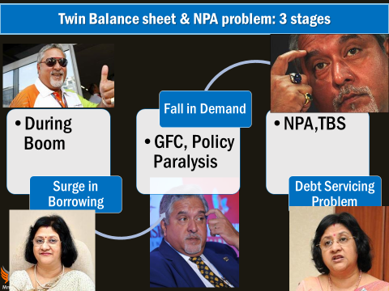
12%
PSB
9.1%
All banks
H1
=first half
FY16
=2015-16

Slide 12

Survey says India’s case is unique!!
TBS
High NPA: economy collapse: East Asia (1998), US & UK (2008), but not in India, even after TBS (2010).
We’ve still managed to get decent growth rate. No ‘bank runs’ coz..
Majority NPA concentrated @PSB, so depositors & investors are not fleeing due to sovereign backing.
Retail loans are not NPA.
Infra loans: excess capacity- fall in production but not ‘collapse’.

Slide 13
India-China “Growth Model” responsible for TBS?
Generous bank loans to corporates, hoping GDP, employment = 3 stages
Phoenix scenario
Containment scenario
% Rapid growth-> cash flow corrected, NPA paid off
In absolute terms of GDP, NPA will shrink and Will fade away from public debate.
But we should not get complacent : because banks over-cautious in lending: hurts growth and demographic dividend.
Notes:
सर्दी जुकाम.

Slide 14



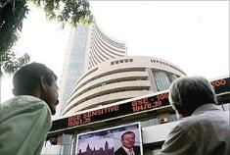
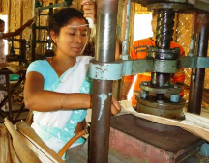
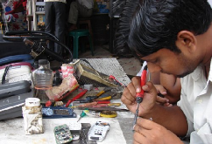
NPA+TBS=>Banks became very cautious in lending
Not hurt
Agri-loans: due to PSL rules
Less Hurt
Corporates: can approach capital market, issue new bond, debentures
Most hurt
Home loans: good record in Non-NPA
MSME: can’t approach capital market.
MUDRA but problems of “SPREAD”*
Job-loss, dem dividend, exports ▼
{will learn in classification lecture}

Slide 15


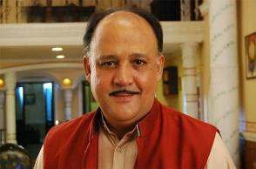
Bank has to increase the “SPREAD” (profit margin) when
Asset
Liability
Spread
2015: 1.6%
2016: 2.7%
Depositor
7%
Borrower
10%
corporates not repaying regularly
People not depositing sufficiently
And still return on assets (RoA) < 1.5!!

Slide 16
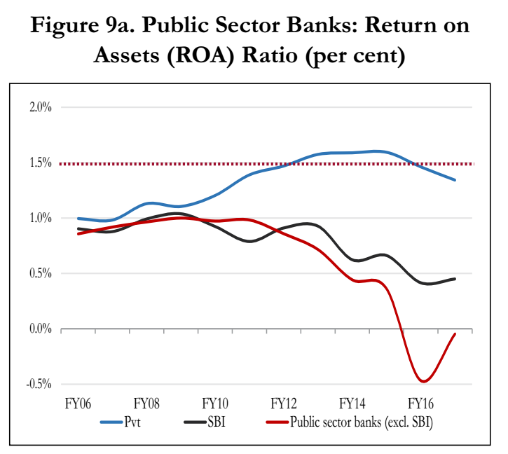
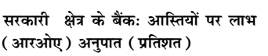
Banks across world have
1.5% ROA

Slide 17

Punjab National Bank: एक चुटकी सिंदूर शेयर की कीमत...
Rising NPA, falling profits…lower dividends ☹
Investors expect large dividend, buying smaller banks

Slide 18

BASEL-III Recapitalization of PSB by 2019, 31st March
Govt: 70kCr (IndraDhanush)
+ Capital Market __?
1.8 Lcr. needed
Based on performance & profitability..so PNB ☹
PSB have 9+ ___
10.8 needed
FPO Shares
Bonds
Demand higher interest else lukewarm response
Lukewarm response
Excess preferential shares without voting power: profit spent on dividends, future expansion hurt.
Profitability further declines
Capital: ___?
9% CRAR for BASEL-III
RWA: 120 LCr
similar reason when flipkart & other startup ‘valuation’ ▼; future expansion will be hurt
Notes:
7th PC : First two years salary? Some say equity with 5.1% return minus 0.1% as Administrative charge?
Return on Asset (ROA) <1.5%.
shares fell by 2/3rd of face value-> when new shares are issued to meet BASEL-III, unlikely to get market response.

Slide 19
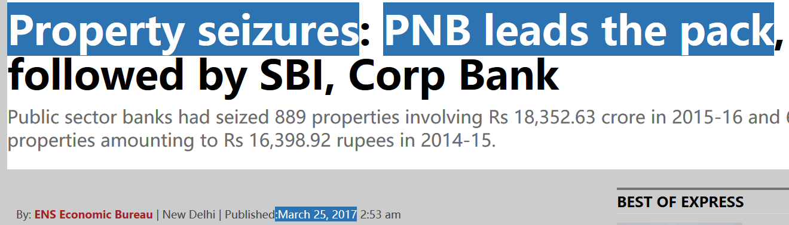
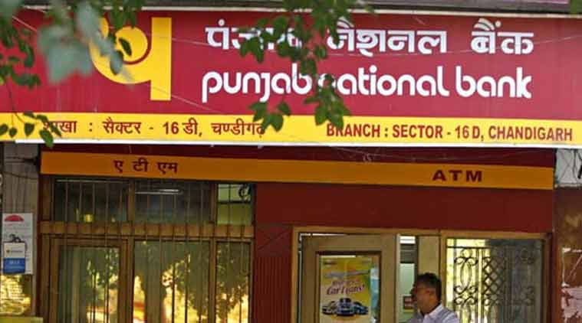

Slide 20
Twin Balance Sheet Problem and its consequences
Public Sector Banks
Large Corporates
What is NPA ? What have we done to fix it?

Slide 21
TBS, NPA problem
Genesis: 3 Stage
3 "R", SDR, S4A
I&B Code 2016
PARA-Bad Bank
Windfall Profit
Moral Hazard 4R4D
Money to Open Bad bank

Slide 22
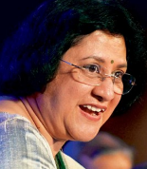
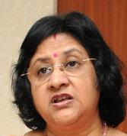



Classification of Bank’s assets
Gross NPA
MINUS “Provisioning”
=NET NPA
Std. Asset
NPA
Doubtful
Loss
Substd.
90 Days: Principal / Interest overdue
NPA+12 months/>
Agri: crop season
Substandard+12 months/>
When Bank, RBI, Auditor says
Little /No salvage value
Early detection of Stress?
“Special Mention Accounts” SMA
Meaning
Classification
Components
Notes:
(2 crop season-short duration crop loan/ 1 crop season- long durati
Reserve Bank of India defines Net NPA as Net NPA = Gross NPA – (Balance in Interest Suspense account + DICGC/ECGC claims received and held pending adjustment + Part payment received and kept in suspense account + Total provisions held). The Reserve Bank of India Banks has advised the banks to compute their Gross Advances, Net Advances, Gross NPAs and Net NPAs as per the following format w.e.f. September 2009. http://www.gktoday.in/answer/what-is-the-difference-in-gross-npa-net-npa/
on)
Gross NPA
Sum of all loans where principal or Interest overdue for 90 days
(-) Provisioning
Banks have to set aside certain amount as “internal-insurance’ against Gross NPA
Net NPA
Gross NPA Minus Provisioning

Slide 23
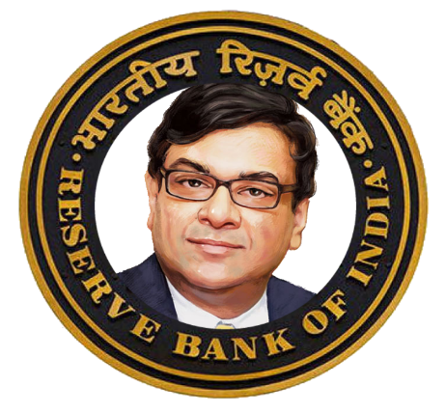




RBI’s repository: Banks + NBFC with loans >5 cr.
If principal / interest not paid
SMA-0: 1-30 days
SMA-1: 31-60 days
SMA-2: 61-90 days
Multiple lenders reporting SMA for single company
Joint Lenders Forum (JLF)
Corrective action plan with majority voting
Not working because of 4C + Media ☹
<hence decentralized Decision Making useless> we need a single “BAD BANK”, says Survey
Notes:
If SMA-2 reported for Rs.100 cr
Joint Lender’s group frame Corrective Action Plan (CAP)
To prevent SMA from NPA

Slide 24
RBI “3R” Framework for Revitalizing Distressed Assets
RECTIFICATION:
RESTRUCTURING:
RECOVERY
SARFAESI Act ‘02
Insolvency & Bankruptcy Code ‘16
No change in EMI, Interest
Ease tenure, Interest(%), ownership change

Slide 25
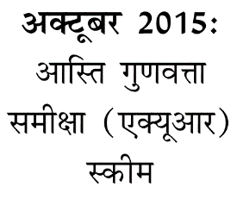

#1: Rectification
3R framework
[2015] AQR: Asset Quality Review of borrower, then ….
Give additional Loan or find new investors in project
But, No change in tenure, interest(%) of the old loan

Slide 26
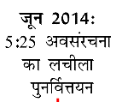

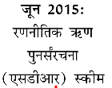
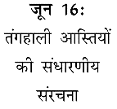
#2: Restructuring
3R framework
[2014] 5/25 for Infra loans: tenure extended to 25 years, interest reviewed each 5 years.
[2015] SDR: “strategic debt restructuring”: Debt (Loan) -> Equity (Shares) & sell them to highest bidder-> = change in ownership.
[2016] S4A: Scheme for Sustainable Structuring of Stressed Assets: only unsustainable portion converted to equity (Preferential Shares) & sold off. No change in ownership.

Slide 27


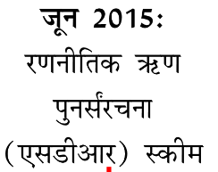

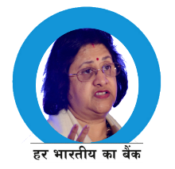
SDR:
Loan->shares
change in ownership
Strategic Debt restructuring
Capital
Equity
Ordinary Shares
Debt
Loan
SDR: Need permission of existing shareholders; hence cases not solved much. This “decentralized approach” not working, so we need a single “BAD BANK” (PARA), says Survey

Slide 28
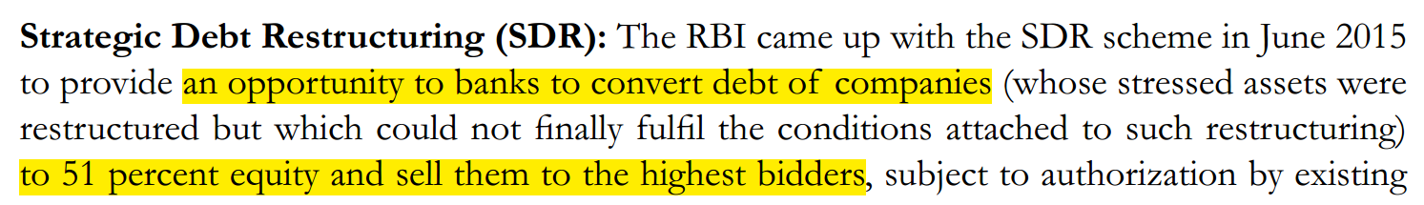
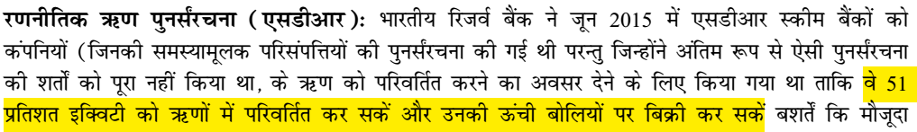
Proof of idiotic Hindi translation (Survey v1 ch.4), many instances in other chapters as well..
English:
Equity (Shares)
Debt (Loan)
Hindi:
Debt (Loan)!!
Equity (Shares)
English Page 103
Hindi Page 104
if official survey (Hindi), has such mistakes, imagine the level of Hindi “COACHING” material. So always prefer to use English resources for success.
Notes:
when has time to translate even “sustainable structuring”= संधारणीय संरचना!

Slide 29
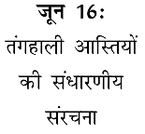

Scheme for Sustainable Structuring of Stressed Assets
S4A: only “unsustainable” portion converted to preferential shares without voting power.
No change in ownership
Capital
Equity
Ordinary Shares
Preferential Shares without voting power Rs. 10
Debt (100)
Loan: 90
S4A: No Need for permission of existing shareholders

Slide 30
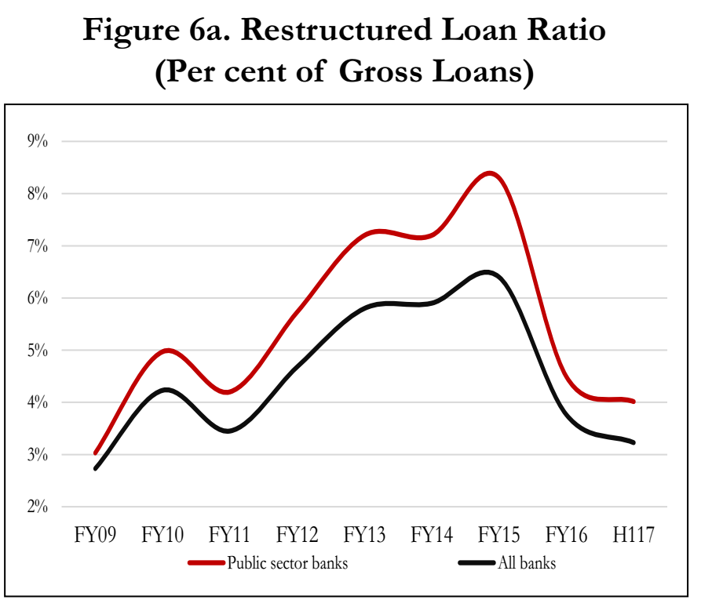
Because even after restructuring. Unable to revive-> NPA
Plus, fear of 4C [Court, CAG , CVC, CBI] + Media & PR
Hence we need a single BAD BANK (PARA) for faster resolution of NPA
FY16=
ending on 31/3/16
H1= first half of financial year
Notes:
http://www.arthapedia.in/index.php?title=Financial_Year_(FY)_or_Fiscal_Year

Slide 31

RBI “3R” Framework for Revitalizing Distressed Assets
RECTIFICATION:
RESTRUCTURING:
RECOVERY
SARFAESI Act
Insolvency & Bankruptcy Code 2016
No change in EMI, Interest
Ease tenure, Interest(%), ownership

Slide 32


Narsimhan-I: Banking sector Reforms (1991)
Securitization and Reconstruction of Financial Assets and Enforcement of Security Interest Act (full form for bank exams)
DEBT
Recovery tribunal ‘93
Sarfaesi’02
Insolvency Bankruptcy Code’16
Narsimhan-II
1998
Because of this….
Since this also did not fix..so

Slide 33



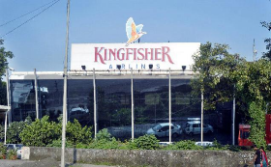


SARFAESI Act Recovery- only Banks and Housing finance-NBFC
Not agri loans
Only secured / mortgage loans
Attach assets without court order
Bank can: auction/sale/change BoD-management
Get stay order from DRT
Fee: 12k to 1.5L
Banks can’t hold attached assets for >7 years. But, can be sold off to ARC.
CRITICISM: ~5% cases solved in last 2 years
Hence we need BAD Bank (PARA)
Further appeal to DRAT
But must deposit 50% of loan dues first
Notes:
sset reconstruction company (ARC).
They buy NPA (Bad loans) from Banks and try to extract maximum money out of it=profit.
They’ve to register with Reserve Bank of India.
Examples:
ARCIL (India’s first and largest asset reconstruction company (ARC))
Reliance Asset Reconstruction Company Limited by Anil Ambani
ARCs buy NPA using Security Receipts (SR) from QIB convert debt to equity etc. not important for exam
Bank can take possession without court order
Auction /sale
Change Management/BoD
Client can approach DRT (Debt Recovery tribunal)
No help-Debt Recovery Appellate Tribunal (DRAT) but need to deposit 50% of loan first
Mortgaged/secured loans only
Agri. Loans….x

Slide 34
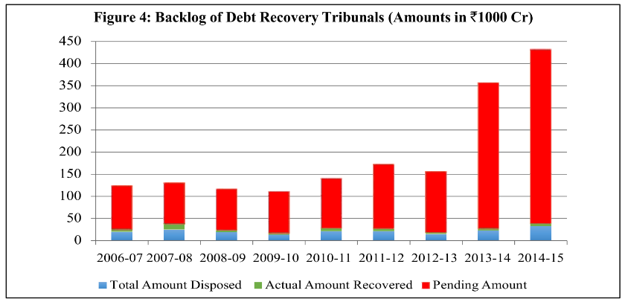

But too much backlog in DRTs & ARC unable to solve many cases ☹
Notes:
>4 lakh crores, hardly any “GREEN”

Slide 35
TBS, NPA problem
Genesis: 3 Stage
3 "R", SDR, S4A
I&B Code 2016
PARA-Bad Bank
Windfall Profit
4R4D

Slide 36
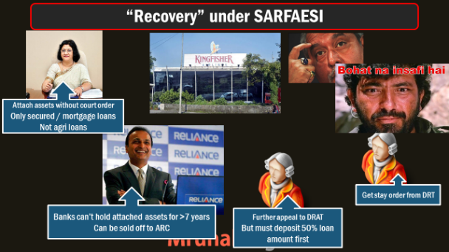


Insolvency and Bankruptcy Code, 2016
What if there was an arbitration “outside” this box?
Notes:
http://www.prsindia.org/uploads/media/Bankruptcy/Bill%20Summary-%20Insolvency%20and%20Bankruptcy.pdf

Slide 37

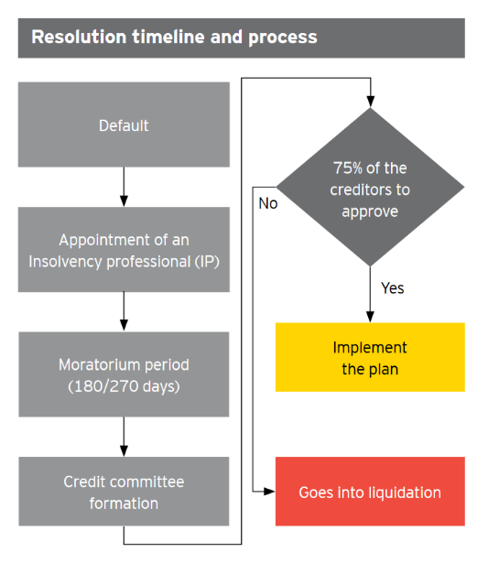




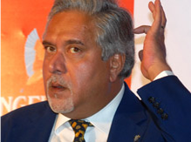
Adjudicator will workout “REPAYMENT” Plan
Insolvency professional (IP)
सुलेमान भाई,
ध माँडवाली बादशाह
5/25, SDR/S4A
Change tenure, interest
Find new investors

Slide 38
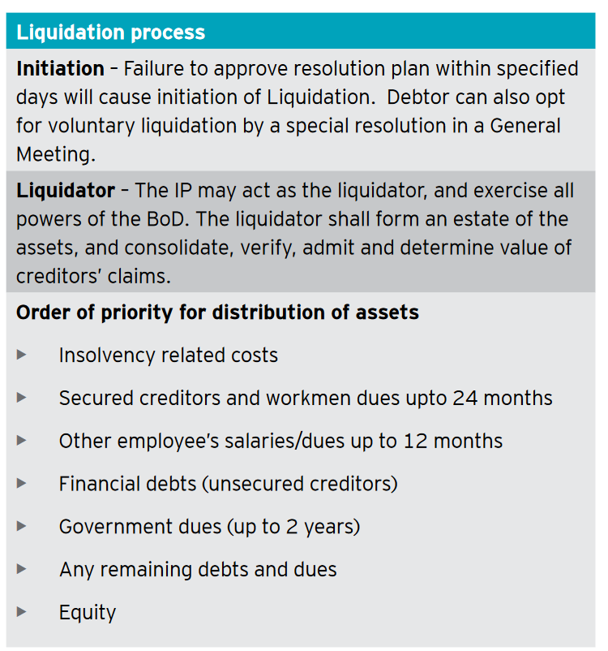
If 75% creditors don’t approve the “REPAYMENT” plan
Insolvency professional (IP)
सुलेमान भाई,
ध माँडवाली बादशाह
Preferential > ordinary shareholder
Notes:
Government’s plan: SAIL, NTPC etc. PSUs to buy off assets of private steel, coal/power companies.
In a way PSB (Bad loan)← paid off by PSU (auction).
But line ministries unhappy, unnecessary purchase obligation / excess-capacity?

Slide 39
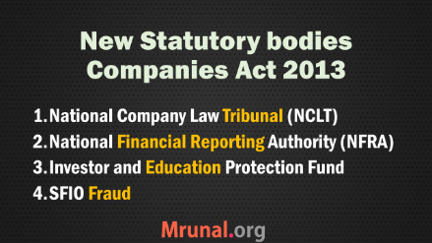

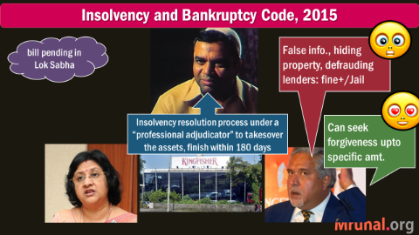
IBC-2016: Appeal structure?
For individual,
Partnership firms
Goto DRT
For companies
NCLT

Slide 40
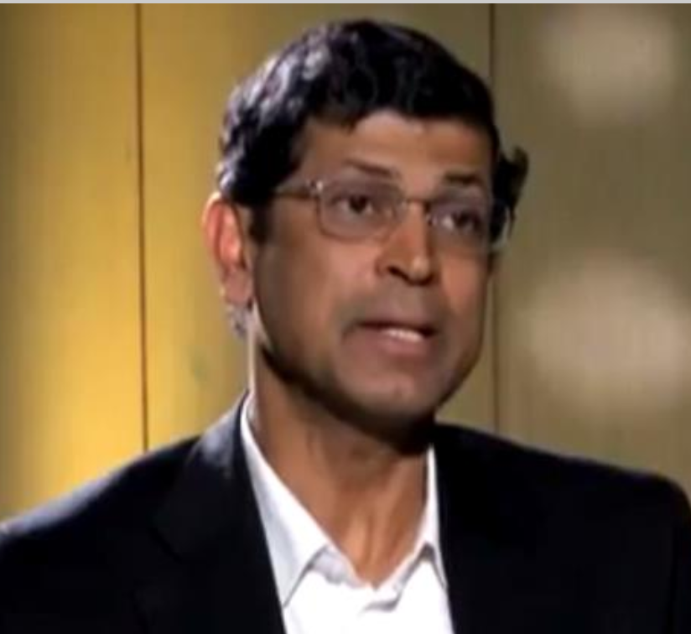



GSM2: Insolvency & Bankruptcy board of India (1+9=10)
Chairman
RBI: 1 nominated
Government
5 nominated
3 Ex-Officio
Law
Finance
corporate
Min. 3 full time
MS Sahoo
Selection Committee u/CabSecy
All Term: 5 years, or 65 age
All Reappointment…yes
Notes:
Board shall consist of the following members who shall be appointed by
the Central Government, namely:—
(
a
) a Chairperson;
(
b
) three members from amongst the officers of the Central Government not
below the rank of Joint Secretary or equivalent, one each to represent the Ministry of
Finance, the Ministry of Corporate Affairs and Ministry of Law,
ex officio;
S
EC
. 1]
THE GAZETTE OF INDIA EXTRAORDINARY
79
(
c
) one member to be nominated by the Reserve Bank of India,
ex officio
;
(
d
) five other members to be nominated by the Central Government, of whom at
least three shall be the whole-time member

Slide 41

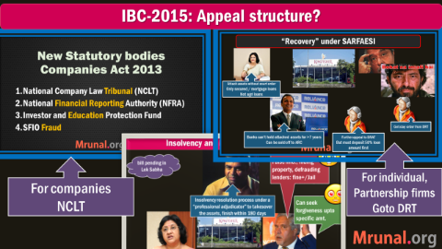


GSM2: (Statutory body) functions of IBBI
Insolvency & Bankruptcy board of India
10 members; Union+RBI
Monitoring and guidelines
Info.utilities for DBM & exchange
I&B Fund
Insolvency professional Agency (IPA) (Ernst & Young, S&P..) even ICAI, Companies Secretary inst etc.
Have registered with IB-board
Insolvency professional (IP)
Have to register with IPA

Slide 42
RBI “3R” Framework for Revitalizing Distressed Assets
RECTIFICATION:
RESTRUCTURING:
RECOVERY
SARFAESI Act ‘02
Insolvency & Bankruptcy Code ‘16
No change in EMI, Interest
Ease tenure, Interest(%), ownership change

Slide 43
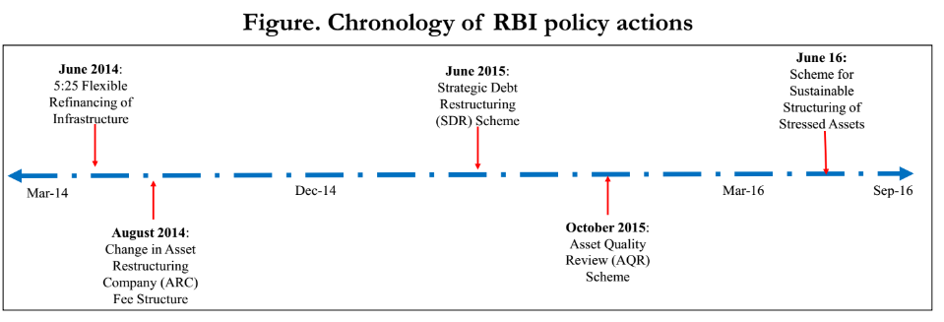
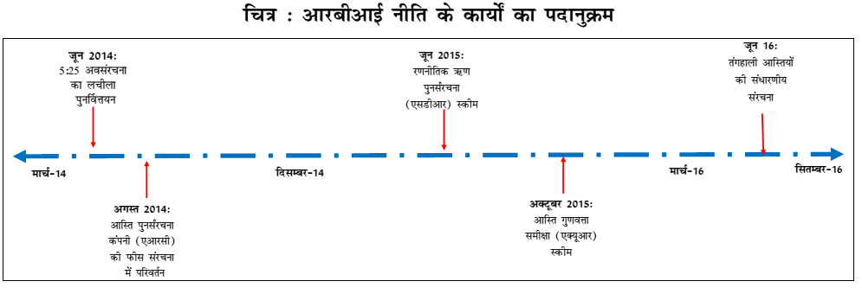

Slide 44
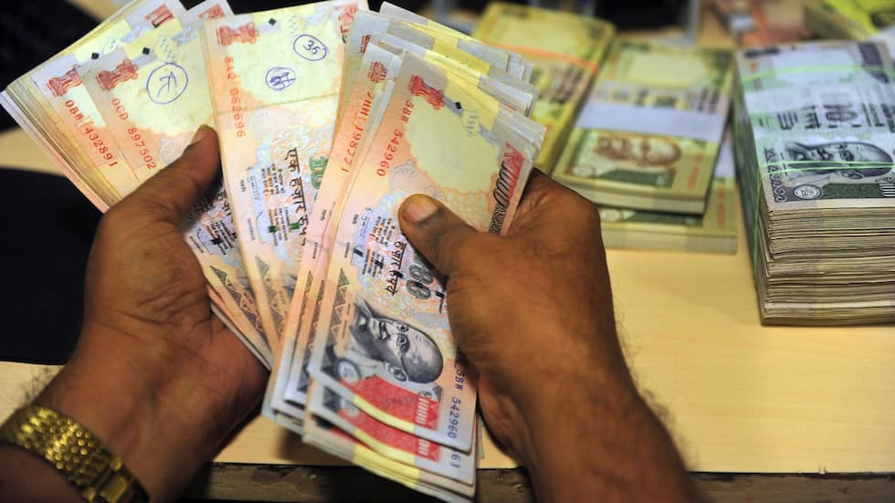
3”R”, SARFAESI, I&B studied but what about…
Farm loans
Debt waiver
Loan write off
Willful Defaulters

Slide 45
SARFAESI Act: Recovery not applicable on Agri loans! ☹
Not agri loans
Only secured / mortgage loans
Attach assets without court order
Bank can: auction/sale/change BoD-management
Get stay order from DRT
Fee: 12k to 1.5L
Banks can’t hold attached assets for >7 years. But, can be sold off to ARC.
CRITICISM: ~5% cases solved in last 2 years
Further appeal to DRAT
But must deposit 50% loan amount first
Notes:
sset reconstruction company (ARC).
They buy NPA (Bad loans) from Banks and try to extract maximum money out of it=profit.
They’ve to register with Reserve Bank of India.
Examples:
ARCIL (India’s first and largest asset reconstruction company (ARC))
Reliance Asset Reconstruction Company Limited by Anil Ambani
ARCs buy NPA using Security Receipts (SR) from QIB convert debt to equity etc. not important for exam
Bank can take possession without court order
Auction /sale
Change Management/BoD
Client can approach DRT (Debt Recovery tribunal)
No help-Debt Recovery Appellate Tribunal (DRAT) but need to deposit 50% of loan first
Mortgaged/secured loans only
Agri. Loans….x

Slide 46


Haircut, One time Settlement “OTS” [farmer has to pay part of the dues]
Agri loans
For tractor loans given before 2011, Sept. and Upto Rs.25 lakh pending
Classified as doubtful / Loss cases on SBI. = Total 6k cr. Worth tractor loans.
One time settlement: Haircut of 40% [means you pay only 60% of the dues back.] Upto 31st march 2017
Branch manager has power, 'tick box approach', non-discretionary.
Earlier similar done to SME [20% haircut] & Educational loans. Recovered 800 cr.
Because something is better than nothing.

Slide 47

Debt waiver = borrowers don’t have to repay the dues.
Agri loan
In loan waiver- Government gives G-sec with long maturity to settle farm dues: just like RIDF- bank will get the amount back, but slowly.
While for short term it improves balance sheet of Bank.
But, will affect the culture of "REPAYMENT". SMA/NPA will rise, Difficult to comply with BASEL-III (because RWA will ▲).
2014: SBI opposed loan waiver in AP & Telangana.
2017: UP & Punjab 10% of SBI's farm loans. UP alone 13k crores. Hence opposed.
no, this will create bad habit.

Slide 48





Paan ki dukaan expressions: Urjit Patel and Arundhati Bhattacharya ars anti-farmer, first let off Mallya with so much loans but won’t do it for farmers.

Slide 49

And similarly, avoid paan ki dukan expressions on “demonetization”
Short term challenges and long term benefits
Black Money
NPA: raise bank deposit, lower interest rates, old loans can be settled, or new loans to revive project
Counterfeiting
Terror Finance
Corruption
Destroying opposition’s “wealth” before UP Election…
Paan ki dukaan expressions

Slide 50
3”R”, SARFAESI, I&B studied but what about…
Farm loans,
Debt waiver
Loan write off
Willful Defaulters

Slide 51


Loan write-off
Balance sheet
Assets
Liabilities
+balance sheet cleanup @HQ
Write-off= Bank’s taxable income ▼=corporation tax ▼
Doesn’t erase the “right to recover”. (“Loan Waiver”)
When recovered- $ added into balance sheet & taxes are paid.
Both RBI & IT Acts allow this.
Anti: executives will become lax in recovering. “moral hazard”
Notes:
PSBs have wrote off 1.14 LC bad debts in 3 years-Indian Express
Once written off, bank executives not keen to recover it.
Less money to lend: interest rates won’t go down.
If recapitalization = tax payers $$ diverted into non-productive, non-plan Expenditure.

Slide 52

Stressed Assets
Stressed assets = NPAs + Written off + Restructured loans [SDR, S4A..]
A) SA> NPA
R) SA=NPA+Written off+restructured
Meaning
Classification
Components
Notes:
http://indianexpress.com/article/business/banking-and-finance/npa-challenge-the-biggest-before-centre-arvind-panagariya/

Slide 53





SC & RBI on Defaulters
NPA
Willful defaulter: ability to repay, but not repaying.
SC asks list of defaulters 500Cr/+ “publish their names”;
RBI: Names in sealed envelop
Can’t disclose names Unless “willful defaulter” (=has capacity to repay, but not repaying).
State bank of India act 1955: section 44 : Confidentiality of clients. Have to amend act.

Slide 54

Rajan, Vinod Rai: NPA and “morality” are not same.
Every defaulter is not willful defaulter
Loan can become bad loan out of bad luck, regulatory clearance, partners' betrayal, time and cost overruns
Economy will “Chill” if….
Only in Fraction of cases- criminality involved.
Entrepreneurs shy away from risk
Banks hesitate in giving loans
Entrepreneurial wealth is not sinful. But each should have opportunity.
If entrepreneur is not willful defaulter, yet tarnishing his image=> market won’t support next project
=GDP, Job creation stagnated
Name them and shame them unless willful defaulter

Slide 55
TBS, NPA problem: NEXT LECTURE….
Genesis: 3 Stage
3 "R", SDR, S4A
I&B Code 2016
PARA-Bad Bank
Windfall Profit
Moral Hazard 4R4D
Money to Open Bad bank

